Slide 1
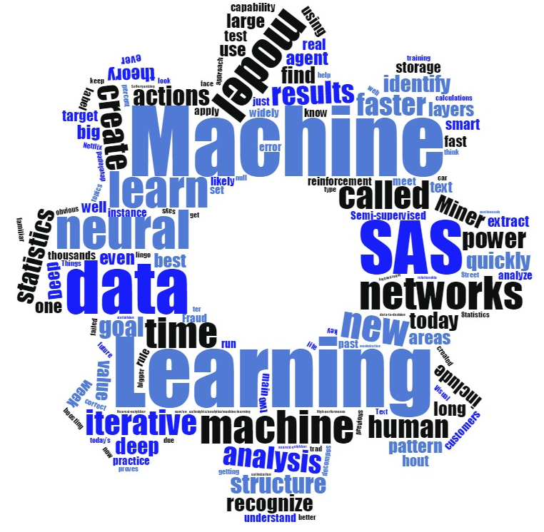
An Artificial Intelligence Framework to Counter International Human Trafficking
Tom Sabo
Principal Solutions Architect
SAS Institute
Notes:
I’ve got the background in text analytics, computer science and machine learning. Some experience with deep learning and computer vision. Many of us are adepts and experts in different areas. Need your help! My ask is this – I’ll present the framework – You look for the ways to insert in AI oriented capability. Talk about SAS and AI, then how we could approach the problem at hand.
My local middle school publishes a weekly paper. Very recently, I noted an article in that paper regarding an expose on human trafficking overseas, "World Slavery: The Terrors Our World Tries to Forget." The eloquent article in part highlighted how children have been exploited in the fishing industry in Ghana and identified organizations that assess and combat human trafficking. It was written by a young woman who has watched my children on a number of occasions. I was impressed by this, that someone so young would take the time to investigate and discuss this issue, focusing on something above the day-to-day that surrounds us in our suburban community.

Slide 2
DATA
ANALYTICS
AI
INTELLIGENCE
Notes:
Introduce SAS is first & foremost an analytics company. Many know SAS just as the programming language. There’s a lot more than that. Today I’ll show you components of an enterprise framework built on SAS to combat human trafficking, empowered by AI and Analytics.
At SAS we’re very interested in the intersection of AI and Analytics. Analytics – The discovery, interpretation, and communication of meaningful patterns in data.
AI – The simulation of human intelligence by machines. The science of training systems to emulate human tasks through learning and automation.

Slide 3
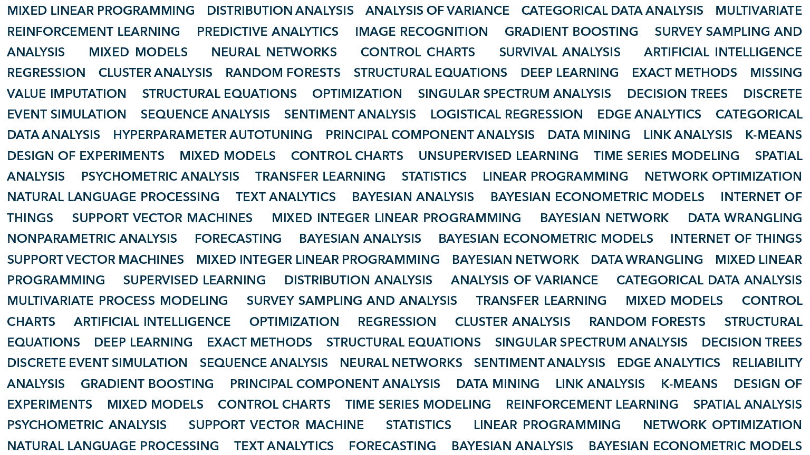
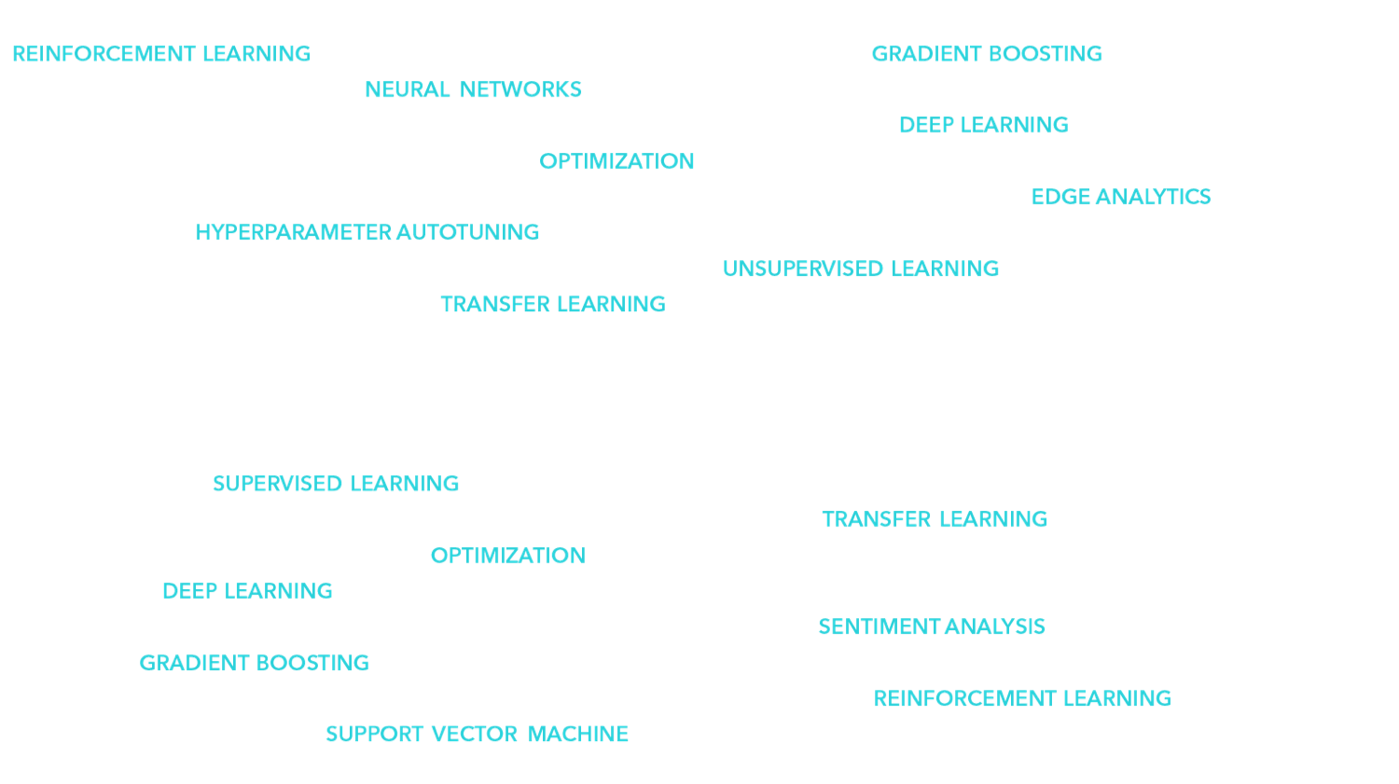
ANALYTICS
AI
Notes:
Many of the AI capabilities we offer are both through SAS code and presented in user-friendly environments. All of it operates on top of our cloud analytical services environment in SAS Viya and is widely scalable. There is much room for integration with open source and open source models in the framework.

Slide 4
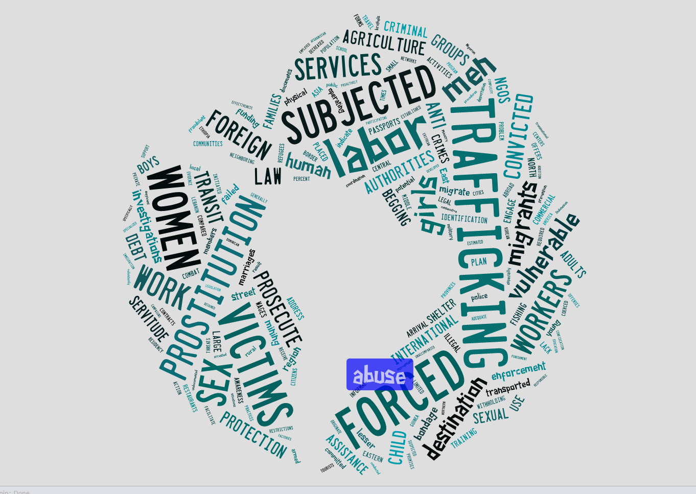
Presenter
John Smith, Business Analyst, ABC Company
Insert your presenter bio here.
John Smith is a business analyst at ABC Company where he has been since 1993. John uses SAS® in his daily responsibilities of quality management. He has used SAS for more than 10 years.
Insert your Twitter handle if applicable.
Notes:
Human trafficking is one of the most tragic human rights issues of our time. Nationally – massage parlors and young adults who are groomed into a life of forced prostitution. Nigerian refugees of armed violence who had documents taken from them in Libya and wind up in slave auctions. Latest ILO figures indicate 40.3M people in modern day slavery – about 1/200 people in the world. 1 in 4 are children. 58% are women and girls.
You can help – this is a call to action – What I’m trying to accomplish today is help you understand how can approach this problem. This is a short presentation. I’ve worked this for awhile, and data that supports this use case is scattered and buried. In some cases, it’s sensitive. Share just a bit on what AI and analytics can do in this space with data I’ve found. Move the ball just a bit forward. Shine a light on how we can use analytics to address these problems. Tech industry is largely not aware of the impact that it can have on assessing and combatting human trafficking.
Source: Global Estimates of Modern Slavery: Forced Labour and Forced Marriage , Geneva, September 2017.

Slide 5
An AI Framework to Counter Human Trafficking
Strategic Objectives
Improve Data Accuracy
Interactive Visualizations
Tactical Objectives
Inform Decisions
Improve Response Accuracy
Artificial Intelligence and Analytics
Data
Integration
Notes:
What I’m proposing – A system that can put together the best of breed capabilities available in data management, analytics, AI and visualization. We’re building this today, and I’m going to show pieces of the puzzle to indicate that this is quite possible.
Strategic data – Like which countries have a connection
Tactical – How should an NGO in Nigeria react to an increasing number of armed conflict events in its northeast region
Data model – Organization and enhancement of my data – AI methods for computer vision, entity detection and resolution
Integration – Can we pick up and integrate each new source of data alongside others

Slide 6
Improving the strategic, operational, and tactical operations to counter human trafficking
How can stakeholders make better strategic decisions with multiple data sources?
How can analysts use AI and text to identify trafficking indicators?
How do investigators make tactical decisions on how to prevent and protect human trafficking victims?
Notes:
Spend some time here. Tie these questions and subsequent actionable items back to the goals.

Slide 7
How can stakeholders make better strategic decisions with multiple data sources?

Slide 8
The Trafficking in Persons (TIP) Report is the U.S. Government’s principal diplomatic tool to engage foreign governments on human trafficking
~200 reports created annually
Identifies connections between countries, who, what, when, where of international trafficking
Notes:
The Trafficking in Persons (TIP) Report is the U.S. Government’s principal diplomatic tool to engage foreign governments on human trafficking. It is also the world’s most comprehensive resource of governmental anti-trafficking efforts and reflects the U.S. Government’s commitment to global leadership on this key human rights and law enforcement issue. It represents an updated, global look at the nature and scope of trafficking in persons and the broad range of government actions to confront and eliminate it. The U.S. Government uses the TIP Report to engage foreign governments in dialogues to advance anti-trafficking reforms and to combat trafficking and to target resources on prevention, protection and prosecution programs. Worldwide, the report is used by international organizations, foreign governments, and nongovernmental organizations alike as a tool to examine where resources are most needed. Freeing victims, preventing trafficking, and bringing traffickers to justice are the ultimate goals of the report and of the U.S Government's anti-trafficking policy.
Each analysis has to start with something.,
Can we identify and geospatially visualize linkages in trafficking between countries?
https://www.state.gov/j/tip/rls/tiprpt/countries/2017/index.htm
~200 reports annually -> 63,648 sentences

Slide 9
Assessment Objectives
Can we identify and geospatially visualize linkages in trafficking between countries?
Notes:
Aka – You can’t model for everything. Sometimes a rule-based approach by itself provides both better results as well as explainability.
Many patterns we can look for in this data. This is just one that has a large visual impact.
Explain our rules-based approach – I’ll show graphical user interfaces to do this later…

Slide 10
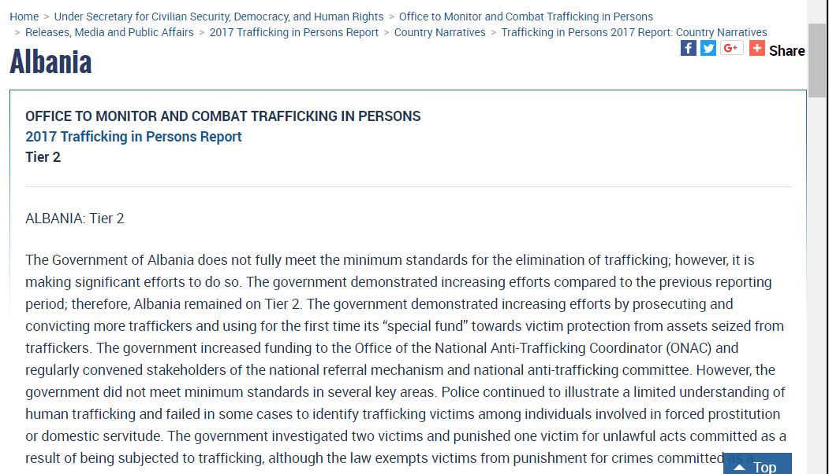
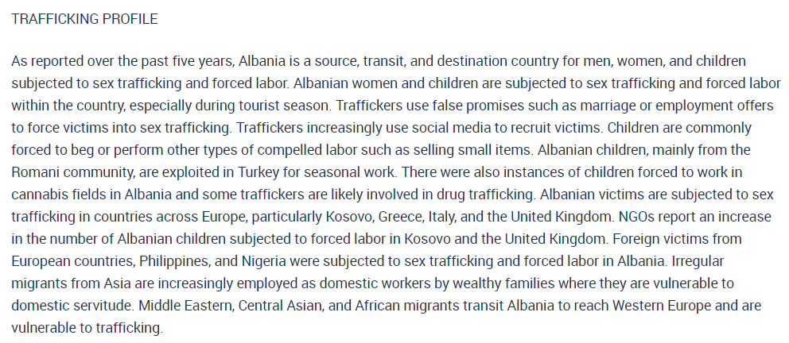

Slide 12
Extract and Create Structured Data from Text
“NGOs report an increase in the number of Albanian children subjected to forced labor in Kosovo and the United Kingdom.”
SAS Text Analytics Engine
Year | Men | Women | Children | Forced Labor | Sex Trafficking | Base Country | Relation Country
2017 | 0 | 0 | 1 | 1 | 0 | Albania | Kosovo
2017 | 0 | 0 | 1 | 1 | 0 | Albania | UK
Notes:
We can use text analytics to create structured data from unstructured data
One sentence example

Slide 13
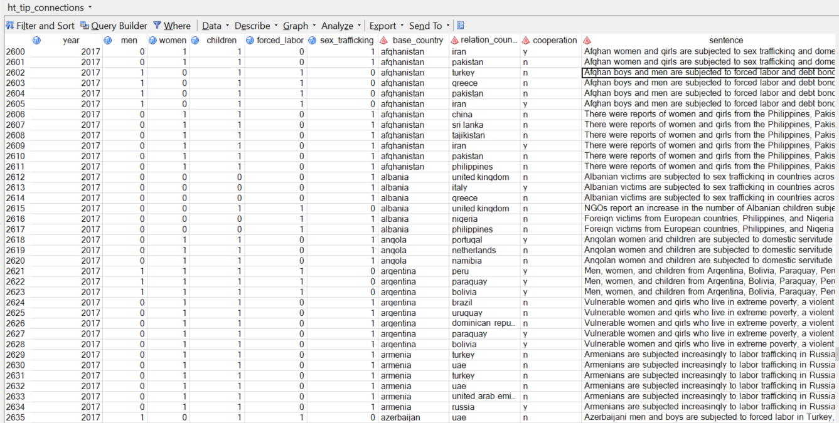
Notes:
3066 links between source, destination countries between 2013-2017

Slide 14
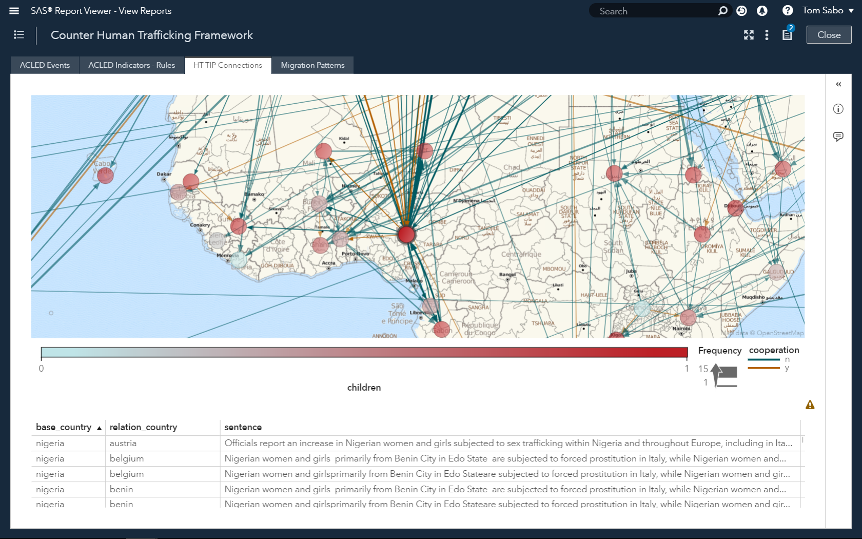

Slide 15
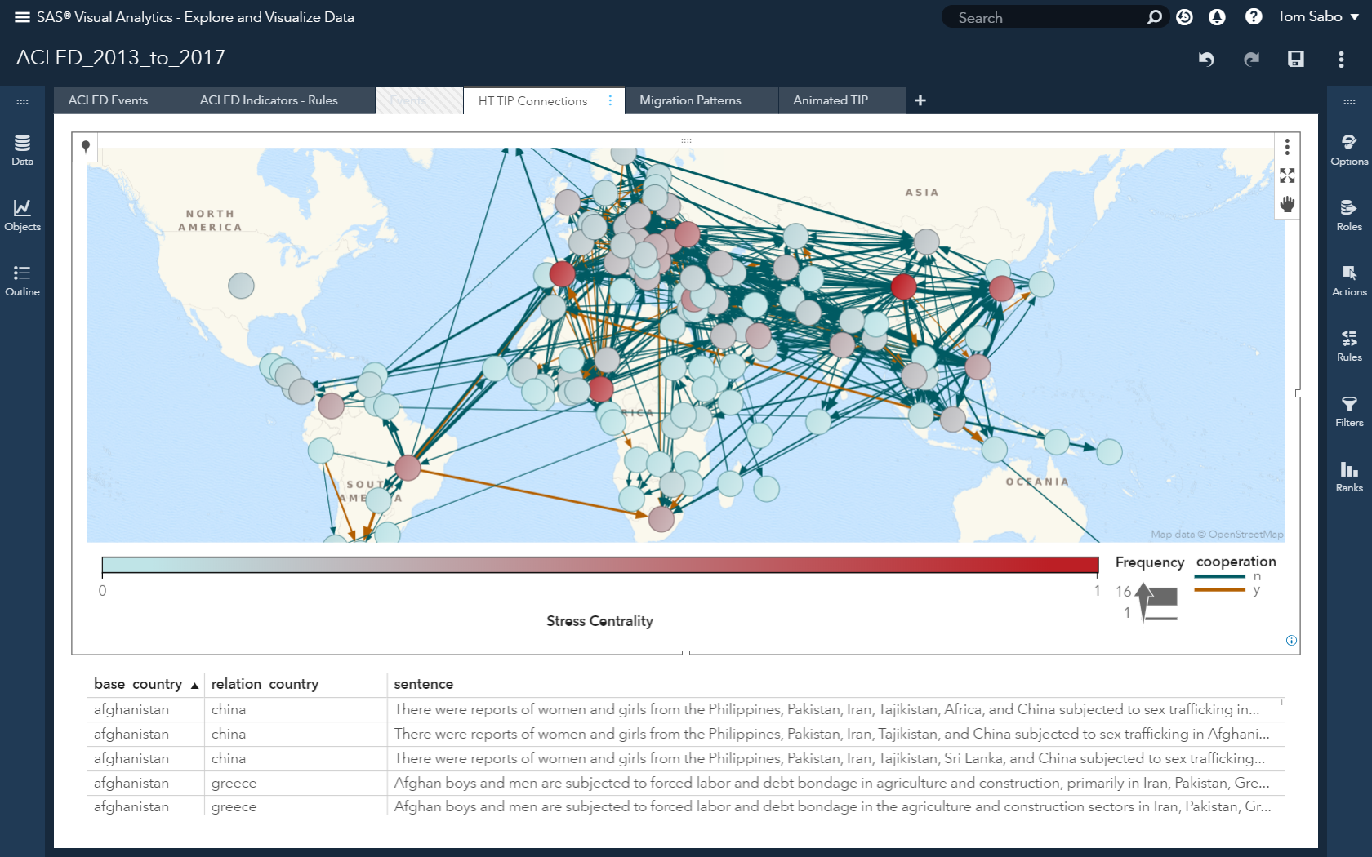
Notes:
Before color showed children, now stress centrality
I’d like to know more about Nigeria but I don’t have that from this dataset alone. How do I expand what I am trying to do?
A variety of network metrics comes out-of-the-box with the network diagram visualization capability available in SAS Visual Analytics. Metrics include “Stress Centrality” that indicates how frequently a node would be crossed when taking the shortest path between nodes.
Useful, powerful, but manually constructed rule-based models alone are not true AI

Slide 16
The Armed Conflict Location & Event Data Project; www.acleddata.com; is a comprehensive collection of event and conflict data for developing states
234K events from 2013-2017
Armed conflicts create human trafficking vulnerabilities
Notes:
What drives human trafficking internationally? One aspect is armed conflict. In conflict situations traffickers can operate with great impunity. Armed conflicts can drive vulnerabilities to trafficking in persons in different ways. Thus, we propose in our counter trafficking framework capabilities that can link patterns of trafficking in persons with armed conflict event data to better understand how armed conflict creates and exacerbates human trafficking.
Example – People coerced by armed groups into sexual slavery, forced labor. Exploitation while fleeing conflict areas – exploited in industries, service sector, or sexual exploitation.

Slide 17
Differentiate Indicators of Violence against Civilians
Notes:
“I can run a text analytics model to differentiate the key terms and phrases associated to different kinds of violence”

Slide 18
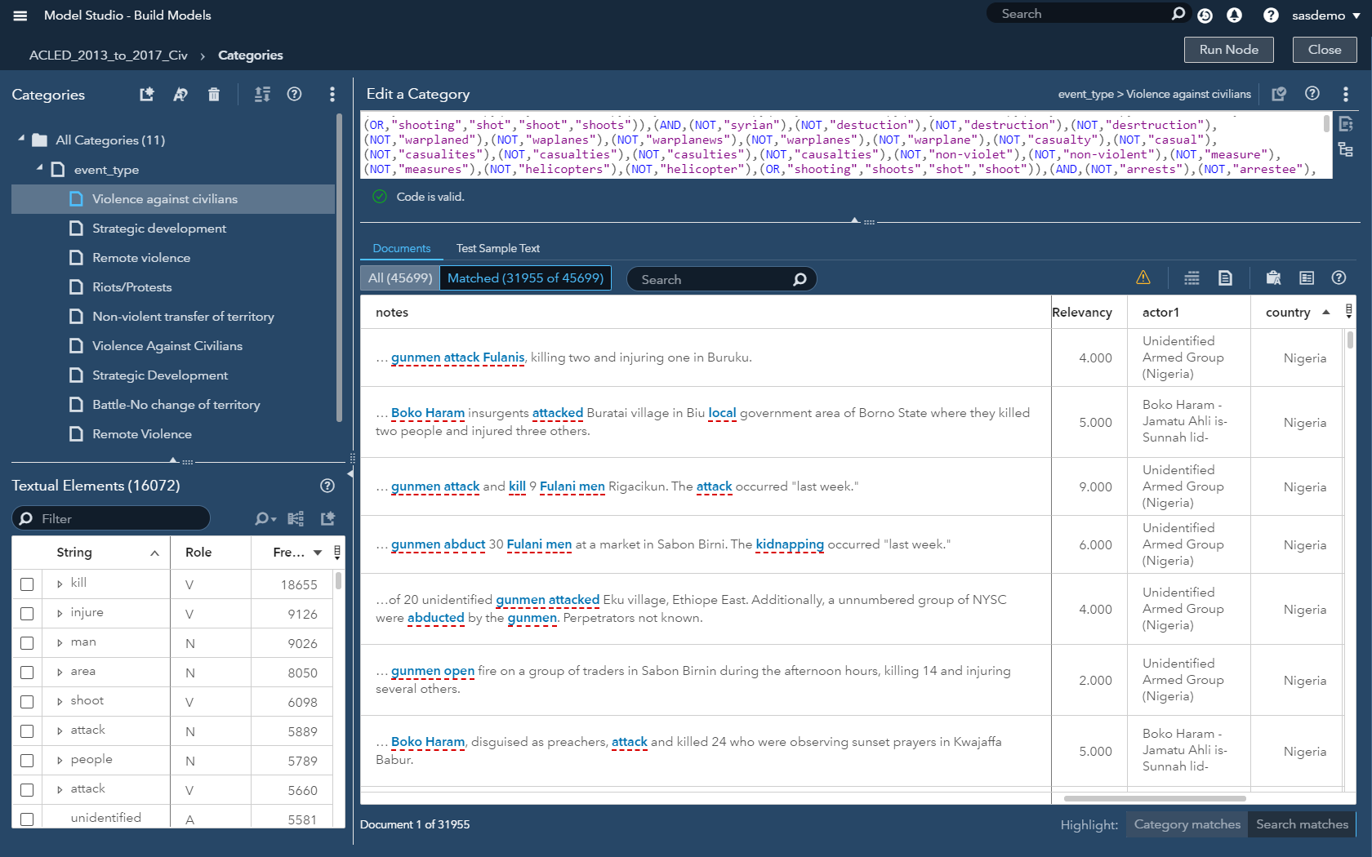
Notes:
Text modeling to generate Boolean rules; statistical/machine learning techniques. Walk through this whole interface.

Slide 19
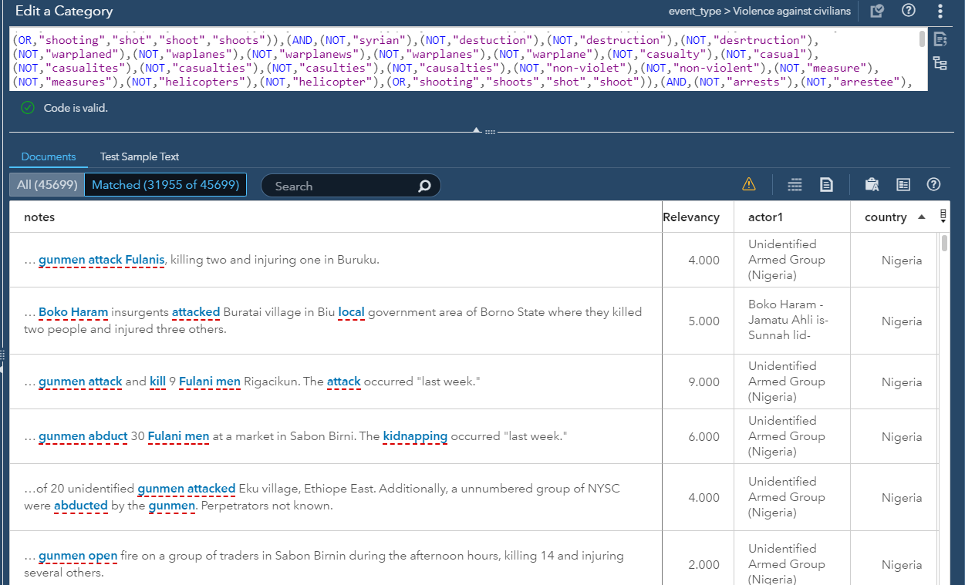
Notes:
Text modeling to generate Boolean rules; statistical/machine learning techniques

Slide 21
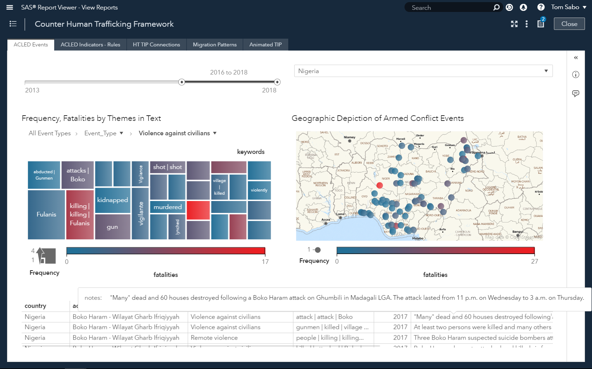
Notes:
This looks good. I also tried the <expand> capacity of VA, but it creates too much to read

Slide 22
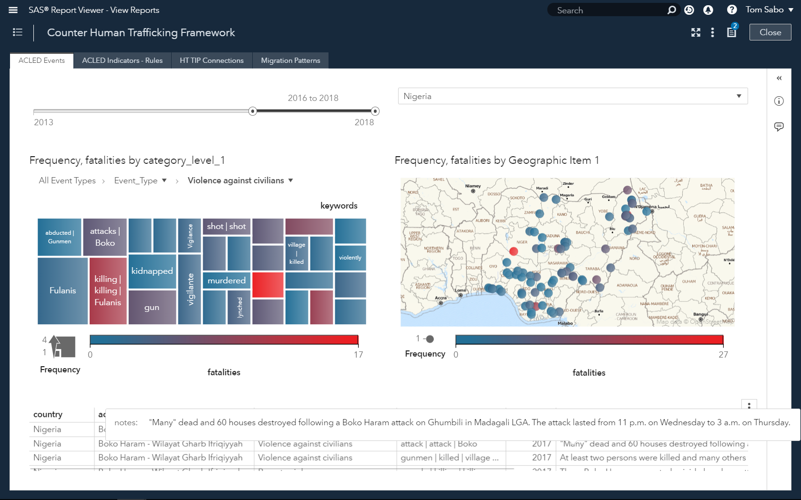
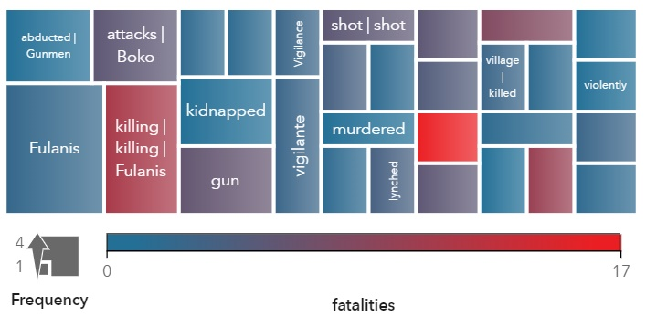

Slide 23
An AI Framework to Counter Human Trafficking
Strategic Objectives
Improve Data Accuracy
Interactive Visualizations
Tactical Objectives
Inform Decisions
Improve Response Accuracy
Artificial Intelligence and Analytics
Data
Integration
Notes:
In summary, we showcased how data from multiple sources can be analyzed using AI and machine learning methods, and subsequently visualized and related to each other. In the process, we showed how such methods assist strategic operations, partly through improved access to relevant data and connections, and partly through verifying assertions in one source against others. Furthermore, we indicated how the use of such a system can help augment existing data models and generate new ones from purely unstructured data sources (in this case, the TIP reports). Finally, this process highlighted the integration of these data sources, and we will explore environments suitable for investigation further in this paper as well when we review the role of SAS Visual Investigator in this process.

Slide 24
How can analysts use AI and text to identify trafficking indicators?
Notes:
When we talk about AI. AI can help us explain things better. Draw associations in a better manner. A usual analytics approach involves someone sitting and making inferences before moving on to the next step.
AI makes it easier to automatically make decisions as well. How can we incorporate that in as well. This could recommend counter trafficking efforts. Even the fact that it’s able to flag something that’s needing attention is good enough.

Slide 25
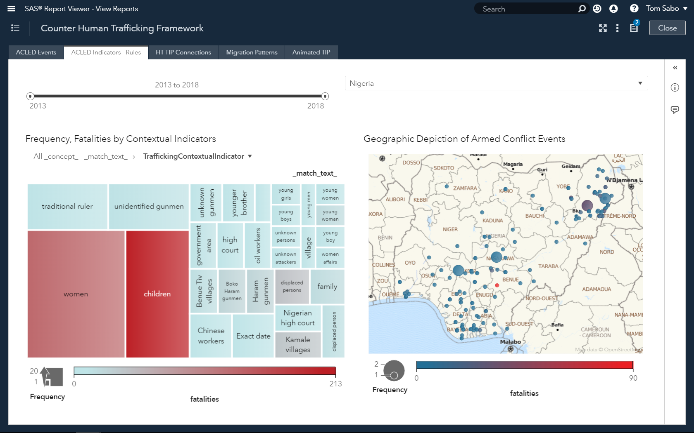
Notes:
Start with the end goal

Slide 26
Build a model to identify victims and HT indicators in armed conflict events
1: Rule-based model
High Precision (potentially), low recall
2: CRF or RNN model and hand-annotated training data
High Precision/Recall, too much time to value
3: CRF or RNN model and rule-based text models to efficiently generate large amounts of training data
High Precision/Recall, lower time to value
Notes:
Option 1 can have high precision (potentially) but low recall – Benefit; help in identifying target variables. Victims is the target, but not black & white. Rules-based can rule out a lot of the noise.
Option 2 can have high precision/recall; low time to value – This alone would involve a lot of noise
Option 3 is worth investigating – Generate large amounts of training data suitable for supervised learning methods

Slide 27
Use a CRF or RNN model with rules-based text models to efficiently generate large amounts of training data
Step 1: Create a rules-based, contextual extraction model to extract a HT_Indicator entity.
Step 2: Format training data to reflect structure needed for CRF/RNN.
Step 3: Train the CRF model to detect entity and predict match boundaries
Step 4: Manually annotate a set of documents as a holdout sample
Step 5: Score the validation dataset
Notes:
1. Using SAS Visual Text Analytics, create a rules-based, contextual extraction model on a sample of data to detect and extract the "Targeted Groups" custom entity. Next, apply this rules-based model to a much larger number of observations, which will form our training corpus for a machine learning algorithm. In this case, we used Conditional Random Fields (CRF), a sequence modeling algorithm also included with SAS Visual Text Analytics. 2. Re-format the training data to reflect the json input structure needed for CRF, where each token in the sentence is assigned a corresponding target label and part of speech. 3. Train the CRF model to detect our custom entity and predict the correct boundaries for each match. 4. Manually annotate a set of documents to use as a holdout sample for validation purposes. For each document, our manual label captures the matched text of the Targeted Groups entity as well as the start and end offsets where that string occurs within the larger body of text. 5. Score the validation “gold” dataset, assess recall and precision metrics, and inspect differences between the results of the linguistic vs machine learning model.

Slide 28
Use a CRF or RNN model with rules-based text models to efficiently generate large amounts of training data
Step 1: Create a rules-based, contextual extraction model to extract a HT_Indicator entity.
Step 2: Format training data to reflect structure needed for CRF/RNN.
Step 3: Train the CRF model to detect entity and predict match boundaries
Step 4: Manually annotate a set of documents as a holdout sample
Step 5: Score the validation dataset
Notes:
1. Using SAS Visual Text Analytics, create a rules-based, contextual extraction model on a sample of data to detect and extract the "Targeted Groups" custom entity. Next, apply this rules-based model to a much larger number of observations, which will form our training corpus for a machine learning algorithm. In this case, we used Conditional Random Fields (CRF), a sequence modeling algorithm also included with SAS Visual Text Analytics. 2. Re-format the training data to reflect the json input structure needed for CRF, where each token in the sentence is assigned a corresponding target label and part of speech. 3. Train the CRF model to detect our custom entity and predict the correct boundaries for each match. 4. Manually annotate a set of documents to use as a holdout sample for validation purposes. For each document, our manual label captures the matched text of the Targeted Groups entity as well as the start and end offsets where that string occurs within the larger body of text. 5. Score the validation “gold” dataset, assess recall and precision metrics, and inspect differences between the results of the linguistic vs machine learning model.

Slide 29
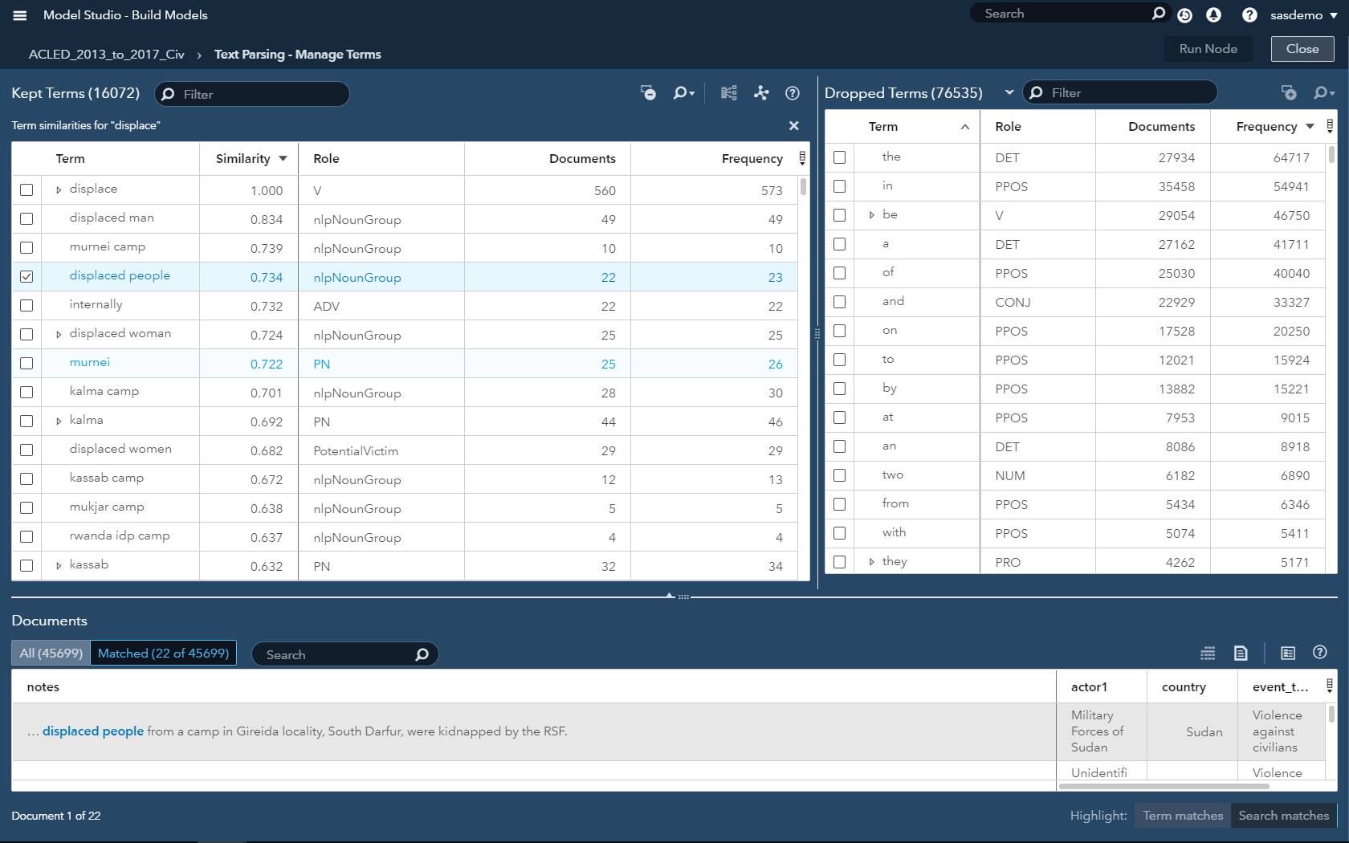
Notes:
Take time here – talk about similarity scores

Slide 30
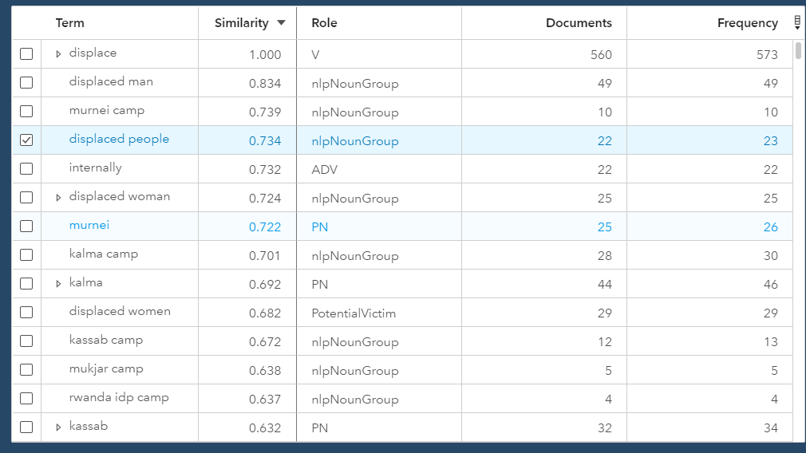

Slide 31
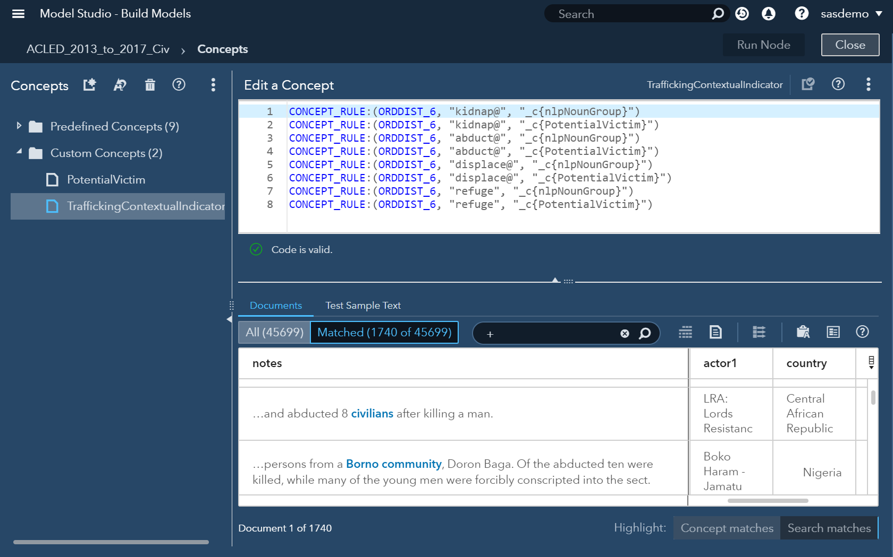

Slide 32
Use a CRF or RNN model with rules-based text models to efficiently generate large amounts of training data
Step 1: Create a rules-based, contextual extraction model to extract a HT_Indicator entity.
Step 2: Format training data to reflect structure needed for CRF/RNN.
Step 3: Train the CRF model to detect entity and predict match boundaries
Step 4: Manually annotate a set of documents as a holdout sample
Step 5: Score the validation dataset
Notes:
1. Using SAS Visual Text Analytics, create a rules-based, contextual extraction model on a sample of data to detect and extract the "Targeted Groups" custom entity. Next, apply this rules-based model to a much larger number of observations, which will form our training corpus for a machine learning algorithm. In this case, we used Conditional Random Fields (CRF), a sequence modeling algorithm also included with SAS Visual Text Analytics. 2. Re-format the training data to reflect the json input structure needed for CRF, where each token in the sentence is assigned a corresponding target label and part of speech. 3. Train the CRF model to detect our custom entity and predict the correct boundaries for each match. 4. Manually annotate a set of documents to use as a holdout sample for validation purposes. For each document, our manual label captures the matched text of the Targeted Groups entity as well as the start and end offsets where that string occurs within the larger body of text. 5. Score the validation “gold” dataset, assess recall and precision metrics, and inspect differences between the results of the linguistic vs machine learning model.

Slide 33
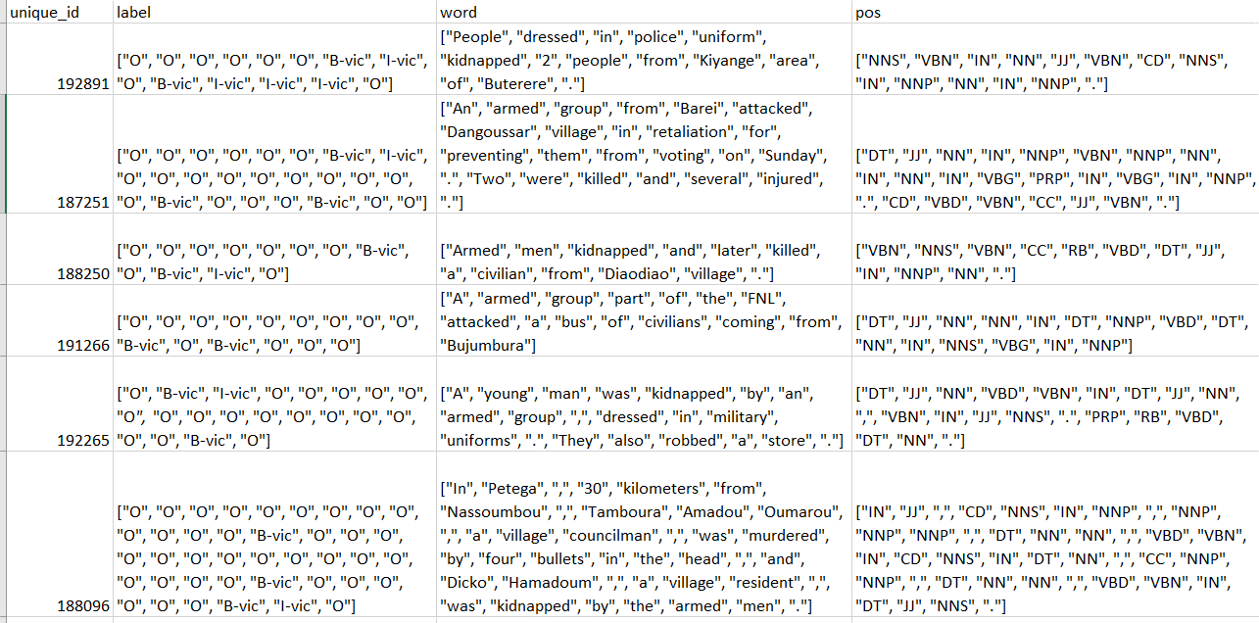
Notes:
IOB2 notation; http://cs229.stanford.edu/proj2005/KrishnanGanapathy-NamedEntityRecognition.pdf; Named Entity Recognition

Slide 34
Use a CRF or RNN model with rules-based text models to efficiently generate large amounts of training data
Step 1: Create a rules-based, contextual extraction model to extract a HT_Indicator entity.
Step 2: Format training data to reflect structure needed for CRF/RNN.
Step 3: Train the CRF model to detect entity and predict match boundaries
Step 4: Manually annotate a set of documents as a holdout sample
Step 5: Score the validation dataset
Notes:
1. Using SAS Visual Text Analytics, create a rules-based, contextual extraction model on a sample of data to detect and extract the "Targeted Groups" custom entity. Next, apply this rules-based model to a much larger number of observations, which will form our training corpus for a machine learning algorithm. In this case, we used Conditional Random Fields (CRF), a sequence modeling algorithm also included with SAS Visual Text Analytics. 2. Re-format the training data to reflect the json input structure needed for CRF, where each token in the sentence is assigned a corresponding target label and part of speech. 3. Train the CRF model to detect our custom entity and predict the correct boundaries for each match. 4. Manually annotate a set of documents to use as a holdout sample for validation purposes. For each document, our manual label captures the matched text of the Targeted Groups entity as well as the start and end offsets where that string occurs within the larger body of text. 5. Score the validation “gold” dataset, assess recall and precision metrics, and inspect differences between the results of the linguistic vs machine learning model.

Slide 35
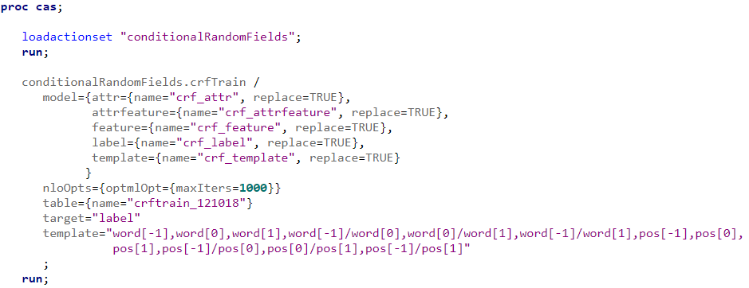
Step 3: Train the CRF model to detect entity and predict match boundaries
Notes:
CAS code on top of SAS Viya

Slide 36
Use a CRF or RNN model with rules-based text models to efficiently generate large amounts of training data
Step 1: Create a rules-based, contextual extraction model to extract a HT_Indicator entity.
Step 2: Format training data to reflect structure needed for CRF/RNN.
Step 3: Train the CRF model to detect entity and predict match boundaries
Step 4: Manually annotate a set of documents as a holdout sample
Step 5: Score the validation dataset
Notes:
1. Using SAS Visual Text Analytics, create a rules-based, contextual extraction model on a sample of data to detect and extract the "Targeted Groups" custom entity. Next, apply this rules-based model to a much larger number of observations, which will form our training corpus for a machine learning algorithm. In this case, we used Conditional Random Fields (CRF), a sequence modeling algorithm also included with SAS Visual Text Analytics. 2. Re-format the training data to reflect the json input structure needed for CRF, where each token in the sentence is assigned a corresponding target label and part of speech. 3. Train the CRF model to detect our custom entity and predict the correct boundaries for each match. 4. Manually annotate a set of documents to use as a holdout sample for validation purposes. For each document, our manual label captures the matched text of the Targeted Groups entity as well as the start and end offsets where that string occurs within the larger body of text. 5. Score the validation “gold” dataset, assess recall and precision metrics, and inspect differences between the results of the linguistic vs machine learning model.

Slide 37
Use a CRF or RNN model with rules-based text models to efficiently generate large amounts of training data
Step 1: Create a rules-based, contextual extraction model to extract a HT_Indicator entity.
Step 2: Format training data to reflect structure needed for CRF/RNN.
Step 3: Train the CRF model to detect entity and predict match boundaries
Step 4: Manually annotate a set of documents as a holdout sample
Step 5: Score the validation dataset
Notes:
1. Using SAS Visual Text Analytics, create a rules-based, contextual extraction model on a sample of data to detect and extract the "Targeted Groups" custom entity. Next, apply this rules-based model to a much larger number of observations, which will form our training corpus for a machine learning algorithm. In this case, we used Conditional Random Fields (CRF), a sequence modeling algorithm also included with SAS Visual Text Analytics. 2. Re-format the training data to reflect the json input structure needed for CRF, where each token in the sentence is assigned a corresponding target label and part of speech. 3. Train the CRF model to detect our custom entity and predict the correct boundaries for each match. 4. Manually annotate a set of documents to use as a holdout sample for validation purposes. For each document, our manual label captures the matched text of the Targeted Groups entity as well as the start and end offsets where that string occurs within the larger body of text. 5. Score the validation “gold” dataset, assess recall and precision metrics, and inspect differences between the results of the linguistic vs machine learning model.

Slide 38
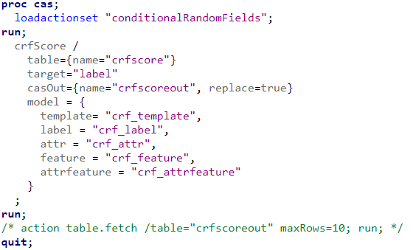
Step 5: Score the validation dataset
Notes:
In summary, although human experts might produce the highest-quality annotations for NER, machine markup can be produced much more cheaply and efficiently -- and even more importantly, scale to far greater data volumes in a fraction of the time. Generating a rules-based model to generate large amounts of "good enough" labeled data is an excellent way to take advantage of these economies of scale, reduce the cost-barrier to exploring new use cases, and improve your ability to quickly adapt to evolving business objectives.

Slide 39
Build a model to identify victims and HT indicators in armed conflict events
1: Rule-based model
2: CRF or RNN model and hand-annotated training da
3: CRF or RNN model and rule-based text models to efficiently generate large amounts of training data
4: Leverage auto-generated concept rules
Enhanced Precision/Recall; Instant results
Notes:
Add sub-bullets with pros/cons; Less text
Option 1 can have high precision (potentially) but low recall – Benefit; help in identifying target variables. Victims is the target, but not black & white. Rules-based can rule out a lot of the noise.
Option 2 can have high precision/recall; low time to value – This alone would involve a lot of noise
Option 3 is worth investigating – Generate large amounts of training data suitable for supervised learning methods

Slide 40
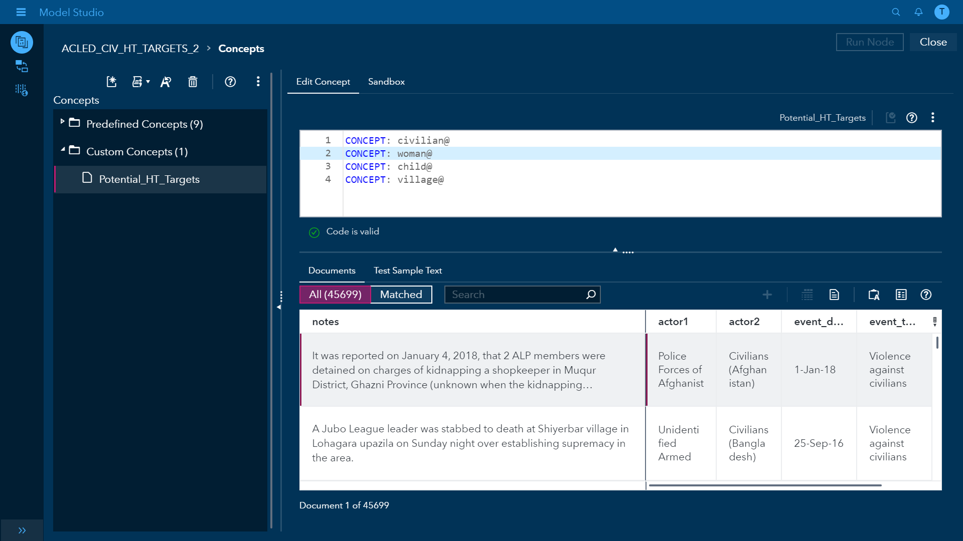

Slide 43
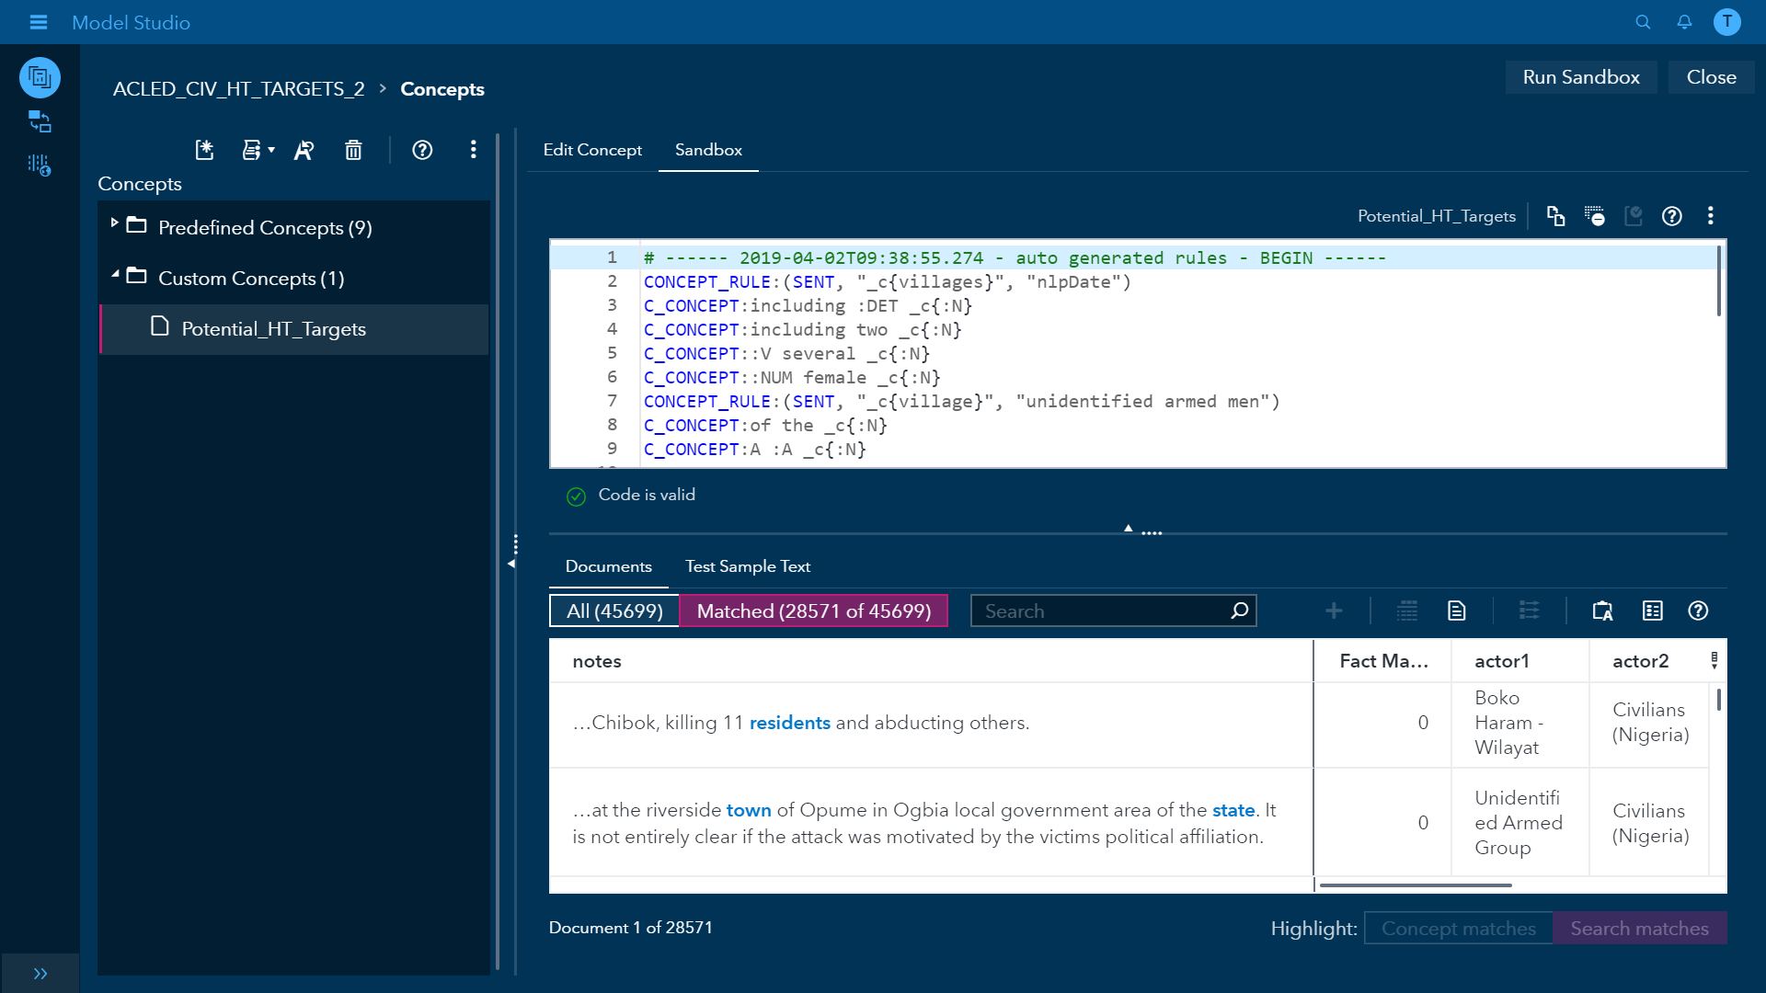

Slide 45
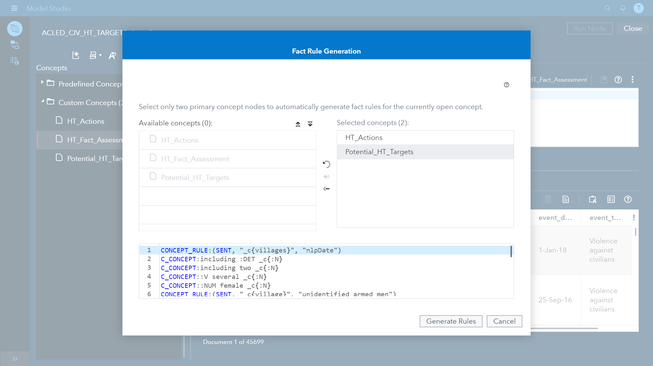

Slide 47
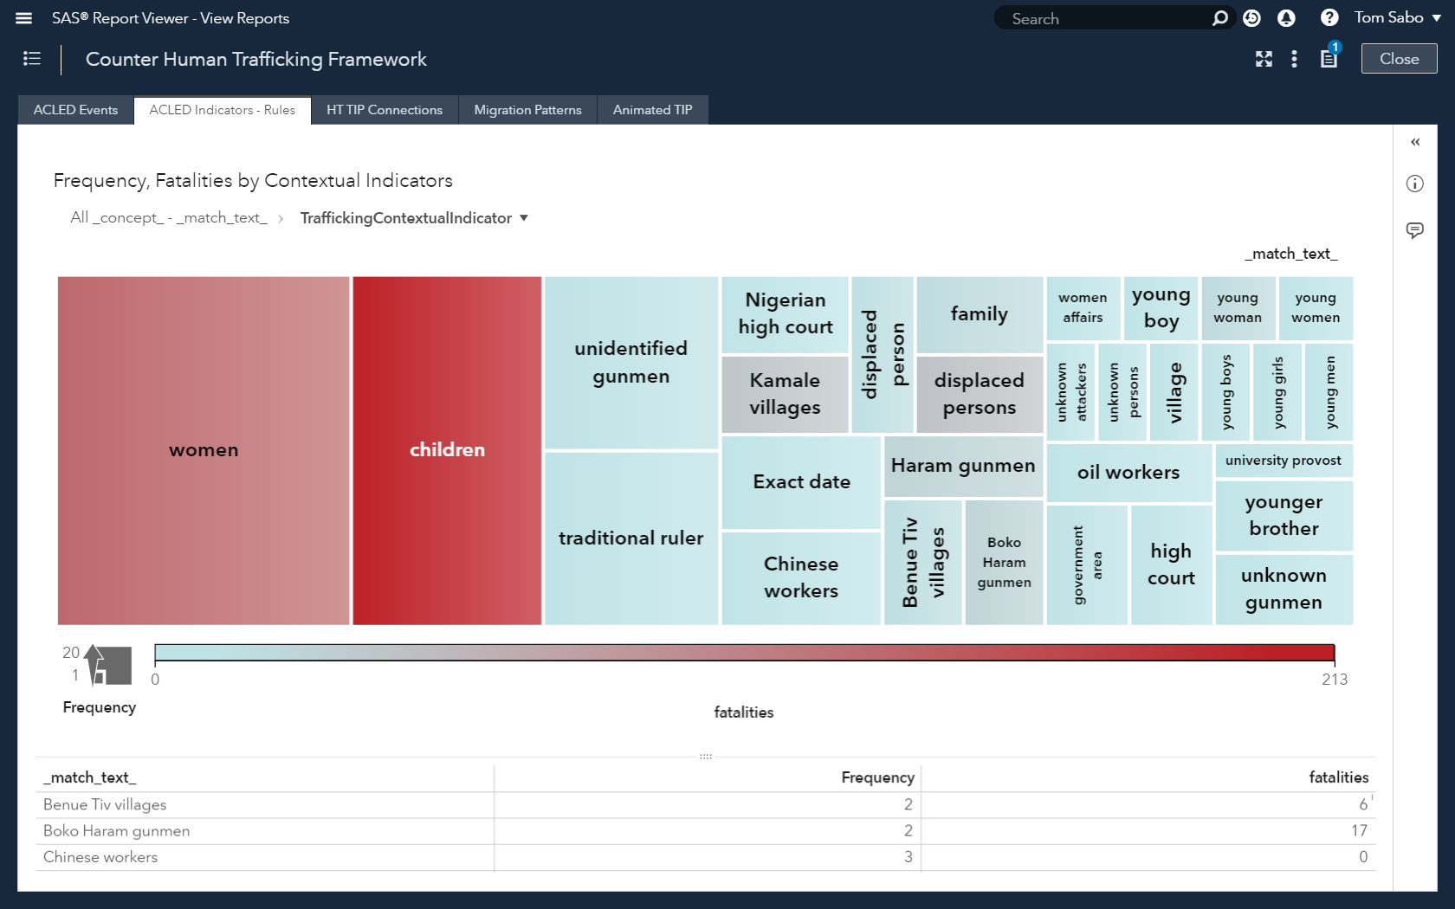

Slide 48
An AI Framework to Counter Human Trafficking
Strategic Objectives
Improve Data Accuracy
Interactive Visualizations
Tactical Objectives
Inform Decisions
Improve Response Accuracy
Artificial Intelligence and Analytics
Data
Integration
Notes:
This exercise gives the analyst new insight into the ways in which individuals, families, and communities are victimized by violent circumstances, as well as answer where and how these actions take place. For instance, while armed conflict events are generally dispersed across Nigeria, most of the armed conflict events involving children take place in the northeast region of Nigeria. Such analysis improves the strategic value of the data, as well as provides answers to operational and tactical questions, such as assessing the impact of a militant group in creating trafficking vulnerabilities. Finally, this assessment of trafficking vulnerabilities adds to the data model of information surrounding the trafficking problem. In the conclusion section at the end of this paper, we will overview how to use this rules-based approach to generate training data for machine learning and deep learning models.

Slide 49
How do investigators make tactical decisions on how to prevent and protect human trafficking victims?
Notes:
Leverage these analytics in an interface that is more accessible to an investigator - How Should I respond to an attack. From govt, or NGO perspective?

Slide 50
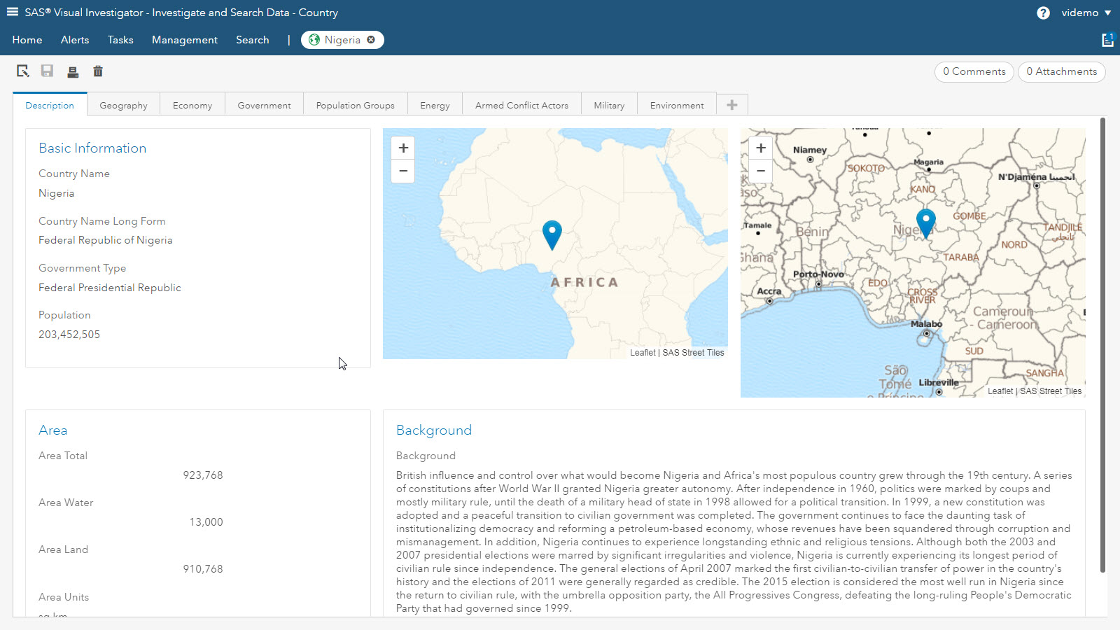
Notes:
Leading up to this slide could be more of the TIP reports. Focus on HT theme.

Slide 51
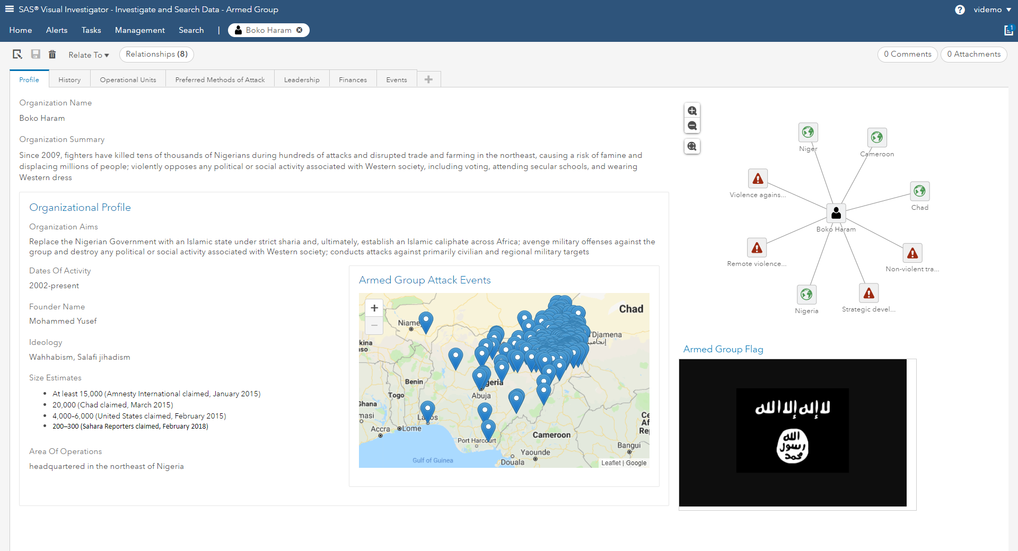
Notes:
Pull data from a wide variety of places to make the decisions. What am I actually trying to do here? Walk through the tabs.
Destruction of a village can result in forced conscription. Walk through the tabs.

Slide 52
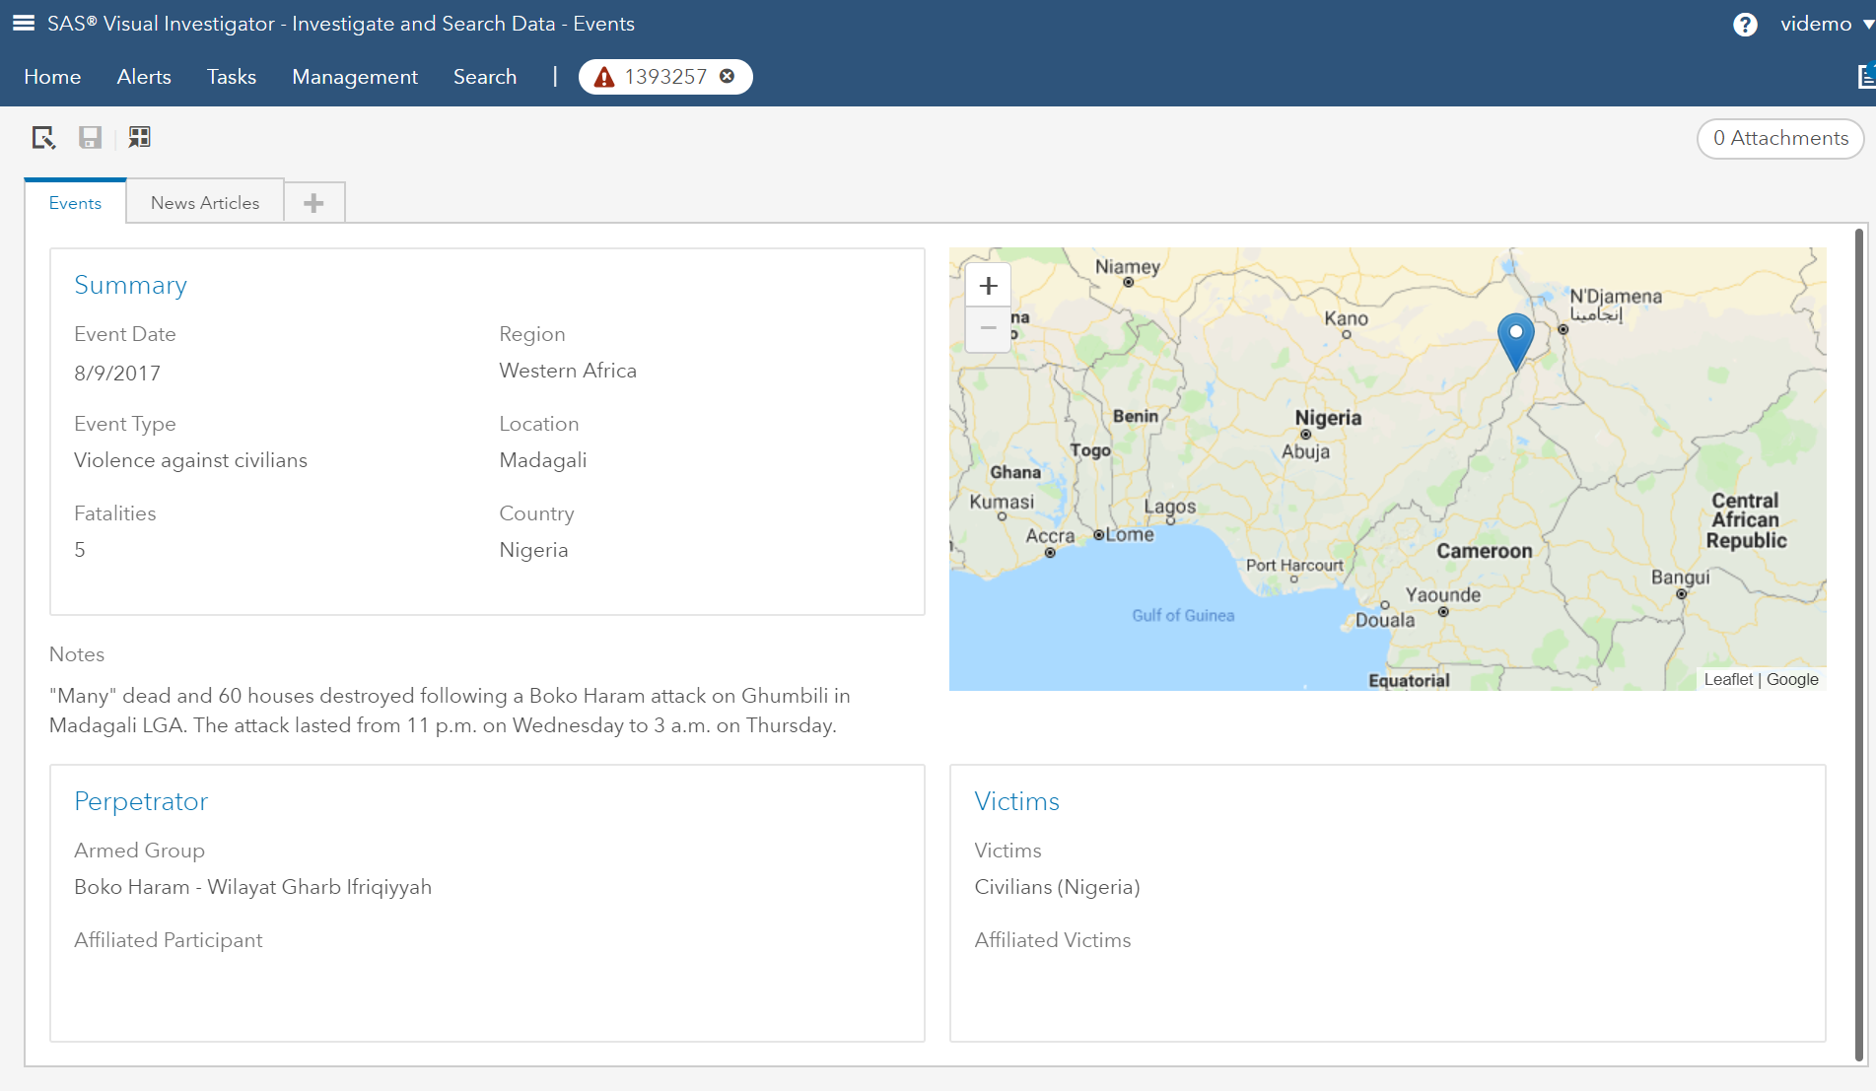

Slide 53
An AI Framework to Counter Human Trafficking
Strategic Objectives
Improve Data Accuracy
Interactive Visualizations
Tactical Objectives
Inform Decisions
Improve Response Accuracy
Artificial Intelligence and Analytics
Data
Integration
Notes:
In summary, such capabilities improve the data model, enabling organization and categorization in a way that assists investigations, as well as providing an environment for integrating new sources of data to assist with the operational/tactical responses to international human trafficking.

Slide 54
Improving the Strategic and Tactical Operations to Counter Human Trafficking Internationally
We showed how to incorporate multiple data sources in one visualization environment to best model and analyze information from those sources of data and make strategic decisions.
We showed how to better target indicators of human trafficking conditions in freeform text using AI methods.
We used SAS Visual Investigator to target the tactical where, what, and how of human trafficking conditions and events utilizing a relational data model.
Notes:
We explored how to incorporate multiple data sources into a single visualization environment. This included how to apply analytics to those sources of data, as well as how to better target indicators of human trafficking conditions in freeform text. The visualizations offered both an analytical and investigative oriented perspective on the data. By answering these questions, we demonstrated how such a solution could be leveraged strategically to improve situational awareness of international human trafficking. We also showed how to apply it tactically/operationally to influence specific response in trafficking areas such as Nigeria. Finally, such a solution supports integrating multiple data sources into data models suitable for investigative and strategic work, as well as extending the value of the data through AI, structured analytics, and text analytics.

Slide 55
An Artificial Intelligence Framework to Counter International Human Trafficking
Tom Sabo
Principal Solutions Architect
SAS Institute

